Slide 1
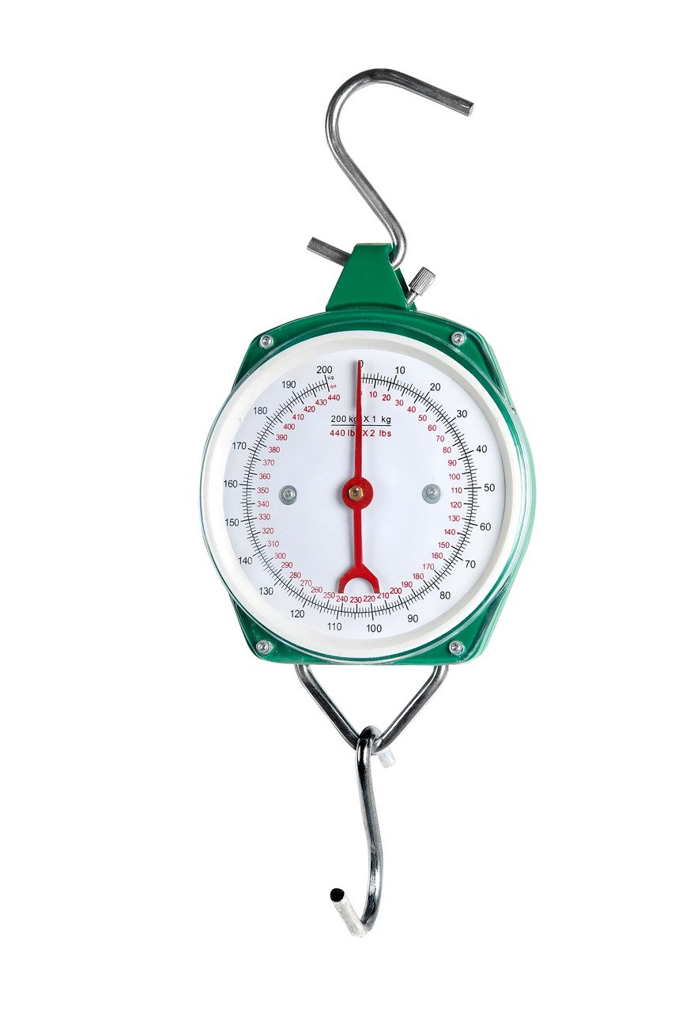
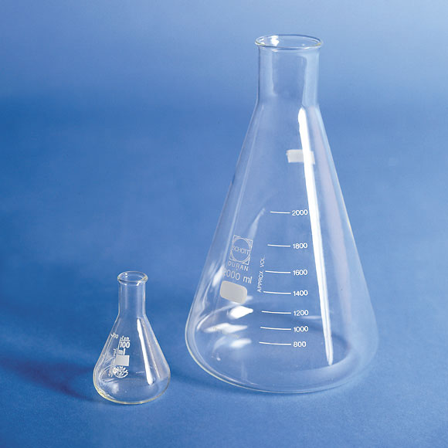
MEASUREMENT AND SCALING

Slide 2
We have ten cans containing kerosene. The cans are numbered 1 to 10.
If we want to measure the kerosene volume of each container . We will pour the kerosene of each can into a calibrated container . Take the corresponding reading and record it /assign to the can number.
In social science we have to develop the scale to measure constructs of our interest

Slide 4
Measurement means assigning numbers or other symbols to characteristics of objects according to certain pre-specified rules.
We measure not the object but some characteristic of it. Thus, we do not measure consumers, We measure their perceptions, attitudes, preferences or other relevant characteristics.
In research, numbers are usually assigned for one of two reasons. First, numbers permit statistical analysis of the resulting data. Second, numbers facilitate universal communication of measurement rules and results.
Scaling involves creating a continuum upon which the characteristics of the measured objects are located.
To illustrate, consider a scale for locating consumers according to the characteristic ‘attitude towards Formula One racing’. Each respondent is assigned a number indicating an unfavorable attitude (measured as 1), a neutral attitude (measured as 2) or a favorable attitude (measured as 3).
Measurement is the actual assignment of 1, 2 or 3 to each respondent.

Slide 5
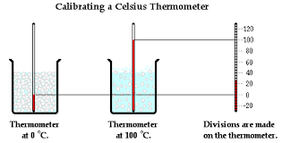

Slide 6
Primary scales of measurement
Nominal
Ordinal
Interval
Scale
Video and exercise

Slide 7
A COMPARISON OF SCALING TECHNIQUES

Slide 8
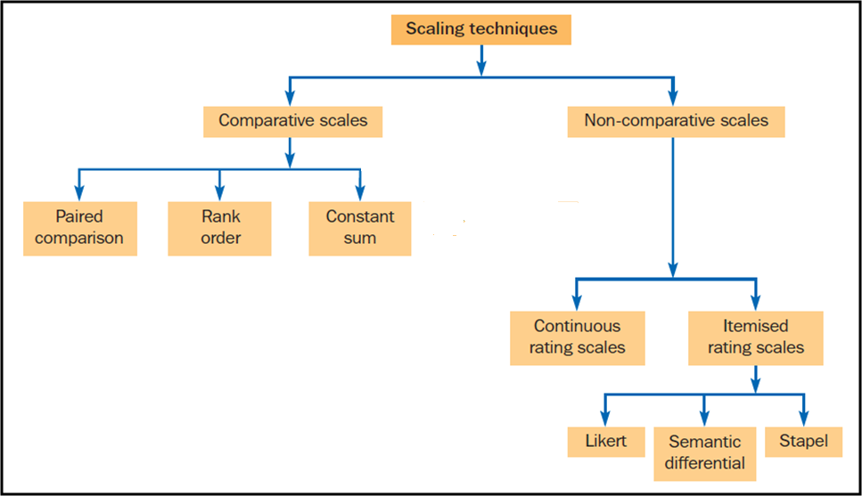
The scaling techniques commonly employed in research can be classified into comparative and non-comparative scales
Important

Slide 9
Comparative scales involve the direct comparison of stimulus objects. For example, respondents may be asked whether they prefer Coke or Pepsi. Comparative scale data must be interpreted in relative terms and have only ordinal or rank order properties. For this reason, comparative scaling is also referred to as non-metric scaling.
As shown in Fig, comparative scales include paired comparisons, rank order, constant sum scales
Non-comparative scales, also referred to as monadic or metric scales, In this each object is scaled independently of the others in the stimulus set. The resulting data are generally assumed to be interval or ratio scaled. For example, respondents may be asked to evaluate Coke on a 1 to 6 preference scale (1 = not at all preferred, 6 = greatly preferred).
As can be seen in Figure non-comparative scales can be continuous rating or itemized rating scales. The itemized rating scales can be further classified as Likert, semantic differential or Stapel scales. Non comparative scaling is the most widely used scaling technique in marketing research.

Slide 10
COMPARATIVE SCALING TECHNIQUES

Slide 11
Paired comparison scaling A comparative scaling technique in which a respondent is presented with two objects at a time and asked to select one object in the pair according to some criterion. The data obtained are ordinal in nature.
Rank order scaling A comparative scaling technique in which respondents are presented with several objects simultaneously and asked to order or rank them according to some criterion.
Constant sum scaling A comparative scaling technique in which respondents are required to allocate a constant sum of units such as points, euros, chits, stickers or chips among a set of stimulus objects with respect to some criterion.

Slide 12
Paired comparison scaling A comparative scaling technique in which a respondent is presented with two objects at a time and asked to select one object in the pair according to some criterion. The data obtained are ordinal in nature.

Slide 13
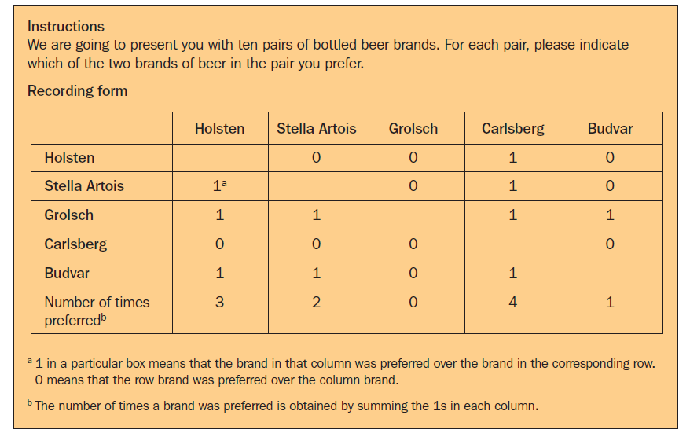
PAIRED COMPARISON SCALING

Slide 14
Rank order scaling A comparative scaling technique in which respondents are presented with several objects simultaneously and asked to order or rank them according to some criterion.

Slide 15
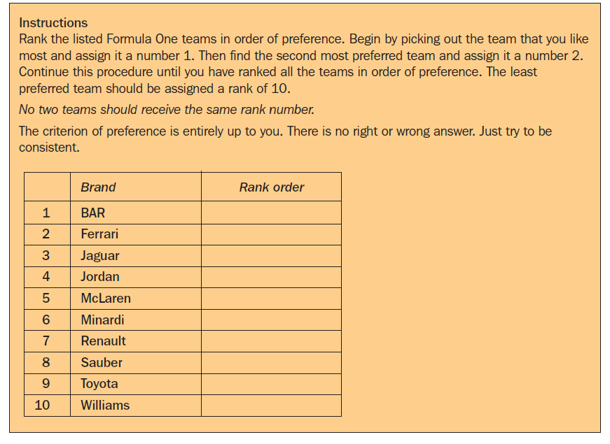
RANK ORDER SCALING

Slide 16
Constant sum scaling A comparative scaling technique in which respondents are required to allocate a constant sum of units such as points, euros, chits, stickers or chips among a set of stimulus objects with respect to some criterion.

Slide 17
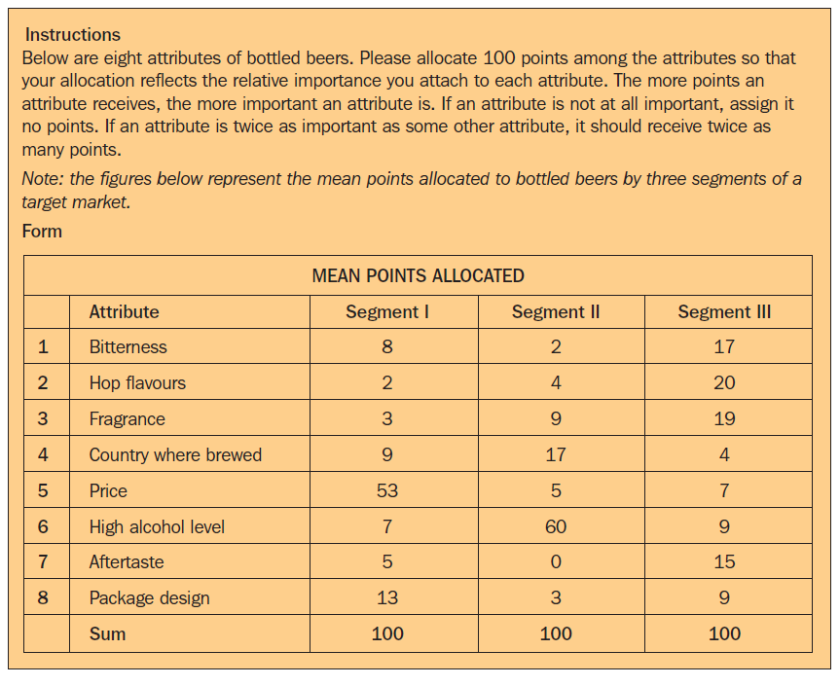
CONSTANT SUM SCALING

Slide 18
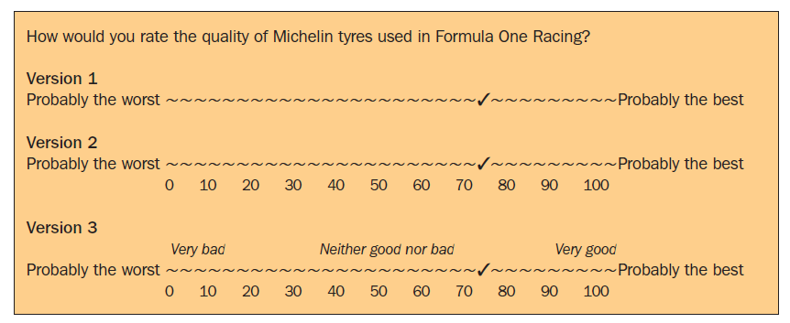
CONTINUOUS RATING SCALE
A measurement scale that has respondents rate the objects by placing a mark at the appropriate position on a line that runs from one extreme of the criterion variable to the other. Also called graphic rating scale.
Three versions of a continuous rating scale are illustrated in Figure

Slide 19
LIKERT SCALE
A measurement scale with five response categories ranging from ‘strongly disagree’ to ‘strongly agree’ that requires respondents to indicate a degree of agreement or disagreement with each of a series of statements related to the stimulus objects.

Slide 20
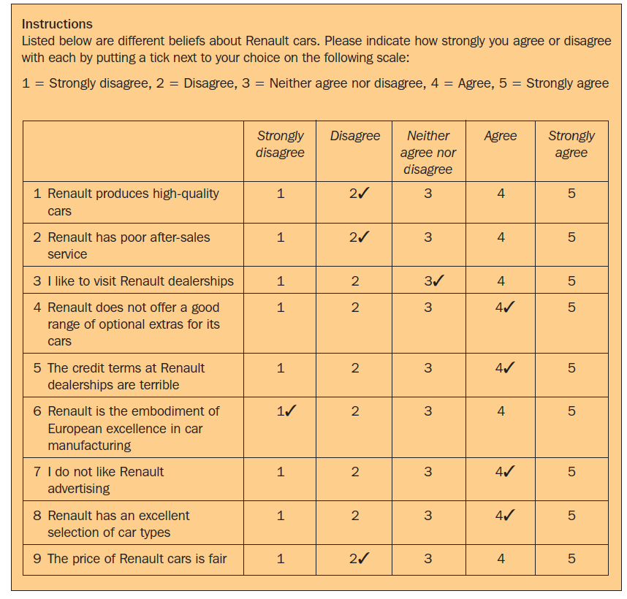
Important
Items which collectively measure the concept of attitude towards Renault car

Slide 21
To conduct the analysis, each statement is assigned a numerical score, ranging either from 1 to 5.
The analysis can be conducted on an item-by-item basis (profile analysis), or a total (summated) score can be calculated for each respondent by summing across items.
Suppose that the Likert scale in Figure used to measure attitudes towards Renault as well as Ford.
Profile analysis would involve comparing the two car manufacturers in terms of the average respondent ratings for each item.
The summated approach is most frequently used, and, as a result, the Likert scale is also referred to as a summated scale.

Slide 23
When using this approach to determine the total score for each respondent on each car manufacturer, it is important to use a consistent scoring procedure.
This requires that the categories assigned to the negative statements by the respondents be scored by reversing the scale. Note that for a negative statement, an agreement reflects an unfavorable response, whereas for a positive statement, agreement represents a favorable response. Accordingly, a ‘strongly agree’ response to a favorable statement and a ‘strongly disagree’ response to an unfavorable statement would both receive scores of 5.
In the example in Figure if a higher score is to denote a more favorable attitude, the scoring of items 2, 4, 5 and 7 will be reversed.
The respondent to this set of statements has an attitude score of 26. Each respondent’s total score for each car manufacturer is calculated. A respondent will have the most favorable attitude towards a car manufacturer with the highest score.

Slide 24
SEMANTIC DIFFERENTIAL SCALE
The semantic differential is a rating scale with end points associated with bipolar labels.
In a typical application, respondents rate objects on a number of itemized, rating scales bounded at each end by one of two bipolar adjectives, such as ‘boring’ and ‘exciting’.

Slide 25
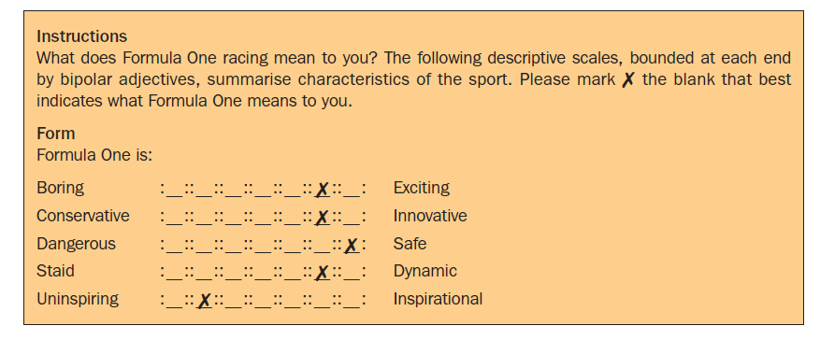

Slide 26
STAPEL SCALE
The Stapel scale is a unipolar rating scale with 10 categories numbered from –5 to +5, without a neutral point (zero).This scale is usually presented vertically.
Respondents are asked to indicate, by selecting an appropriate numerical response category, how accurately or inaccurately each term describes the object. The higher the number, the more accurately the term describes the object.
In this example, Formula One is perceived as being prestigious but not elitist.

Slide 27
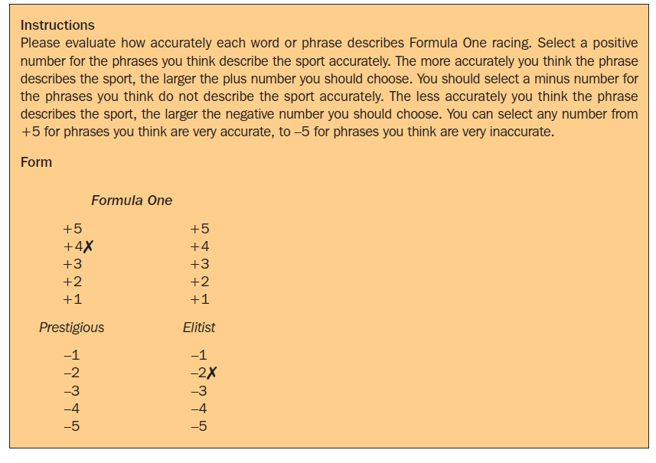

Slide 28
ITEMIZED RATING SCALE DECISIONS

Slide 29
Non-comparative itemized rating scales can take many different forms.
The researcher must make six major decisions when constructing any of these scales:
The number of scale categories to use
Balanced versus unbalanced scale
Odd or even number of categories
Forced versus non-forced choice
The nature and degree of the verbal description
The physical form of the scale.

Slide 30
Number of scale categories
Two conflicting considerations are involved in deciding the number of scale categories or response options.
The greater the number of scale categories, the finer the discrimination among stimulus objects that is possible.
On the other hand, most respondents cannot handle more than a few categories.
Traditional guidelines suggest that the appropriate number of categories should be between five and nine. Yet there is no single optimal number of categories. Several factors should be taken into account in deciding on the number of categories.

Slide 31
If the respondents are interested in the scaling task and are knowledgeable about the objects, many categories may be employed. On the other hand, if the respondents are not very knowledgeable or involved with the task, fewer categories should be used.
Likewise, the nature of the objects is also relevant. Some objects do not lend themselves to fine discrimination, so a small number of categories are sufficient.
Another important factor is the mode of data collection. If telephone interviews are involved, many categories may confuse the respondents. Likewise, space limitations may restrict the number of categories in mail questionnaires.
How the data are to be analyzed and used should also influence the number of categories.

Slide 32
Balanced versus unbalanced scale
In a balanced scale, the number of favorable and unfavorable categories is equal; in an unbalanced scale, the categories are unequal.
In general, in order to obtain objective data, the scale should be balanced.
If the distribution of responses is likely to be skewed, however, either positively or negatively, an unbalanced scale with more categories in the direction of skewness may be appropriate.
Giving charity ----
CSR-----
IIM Ahmedabad

Slide 33
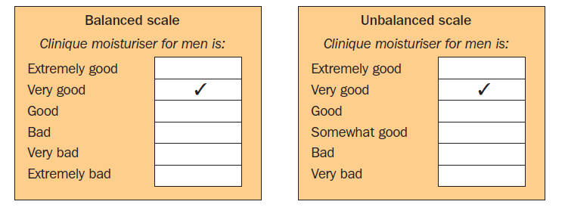

Slide 34
The use of an unbalanced rating scale can be justified in studies in which researchers know in advance that nearly all participants’ scores will lean in one direction or the other. Raters are inclined to score attitude objects higher if the objects are very familiar and if they are ego-involved.
When researchers know that one side of the scale is not likely to be used, they try to achieve precision on the side that will most often receive the participant’s attention.

Slide 35
Odd or even number of categories
With an odd number of categories, the middle scale position is generally designated as neutral or impartial.
The decision to use an odd or even number of categories depends on whether some of the respondents may be neutral on the response being measured. If a neutral or indifferent response is possible from at least some of the respondents, an odd number of categories should be used.
If, on the other hand, the researcher wants to force a response or believes that no neutral or indifferent response exists, a rating scale with an even number of categories should be used.

Slide 36
Forced versus non-forced choice
On forced rating scales the respondents are forced to express an opinion because a ‘no opinion’ option is not provided. In such a case, respondents without an opinion may mark the middle scale position.
Researchers often exclude the response choice “no opinion,” “undecided,” “don’t know,” “uncertain,” or “neutral” when they know that most participants have an attitude on the topic. It is reasonable in this circumstance to constrain participants so that they focus on alternatives carefully and do not idly choose the middle position.
However, when many participants are clearly undecided and the scale does not allow them to express their uncertainty, the forced-choice scale biases results.
In situations where the respondents are expected to have no opinion, as opposed to simply being reluctant to disclose it, the accuracy of data may be improved by a non-forced scale that includes a ‘no opinion’ category.

Slide 37
Nature and degree of verbal description
The nature and degree of verbal description associated with scale categories varies considerably and can have an effect on the responses.
Scale categories may have verbal, numerical or even pictorial descriptions. Furthermore, the researcher must decide whether to label every scale category, label only some scale categories, or label only extreme scale categories.
Surprisingly, providing a verbal description for each category may not improve the accuracy or reliability of the data. Yet, an argument can be made for labeling all or many scale categories to reduce scale ambiguity. The category descriptions should be located as close to the response categories as possible.

Slide 38
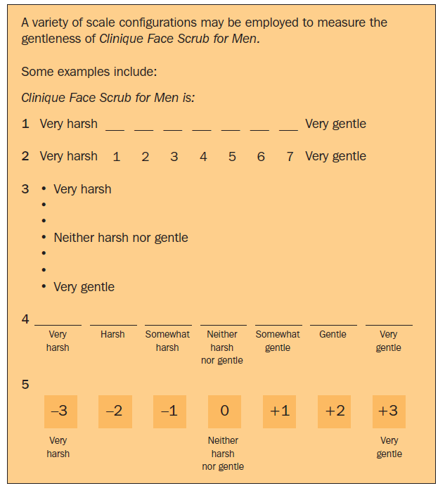

Slide 39
Physical form of the scale
A number of options are available with respect to scale form or configuration.
Scales can be presented vertically or horizontally. Categories can be expressed by boxes, discrete lines or units on a continuum and may or may not have numbers assigned to them. If numerical values are used, they may be positive, negative or both.
Two unique rating scale configurations used in marketing research are the thermometer scale and the smiling face scale. For the thermometer scale, the higher the temperature, the more favorable the evaluation. Likewise, happier faces indicate evaluations that are more favorable. These scales are especially useful for children.

Slide 40
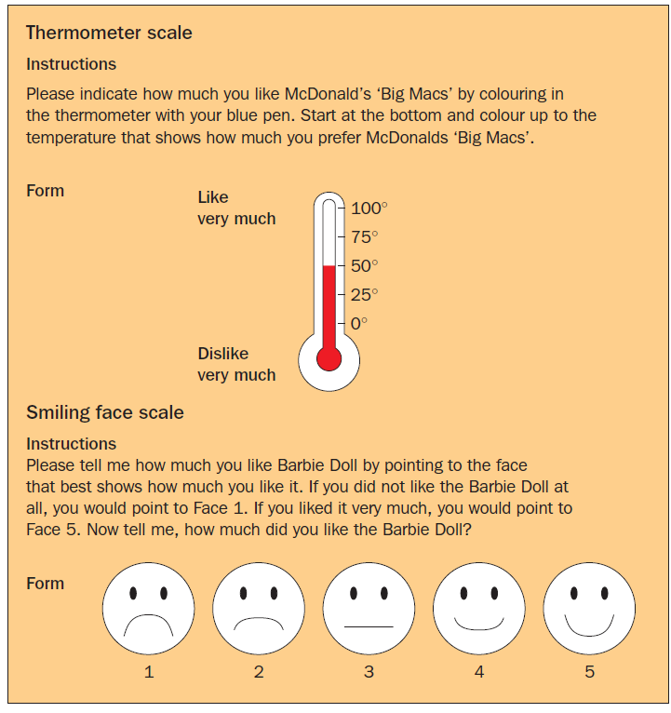

Slide 41
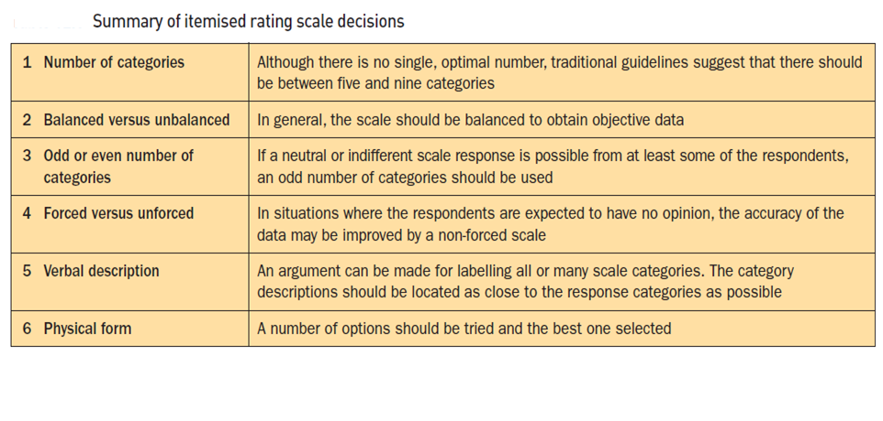

Slide 42
THE DEVELOPMENT AND EVALUATION OF SCALES

Slide 43
Reliability
The extent to which a scale produces consistent results if repeated measurements are made on the characteristic.
Validity
The extent to which a measurement represents characteristics that exist in the phenomenon under investigation.

Slide 44
THANK YOU

Slide 45
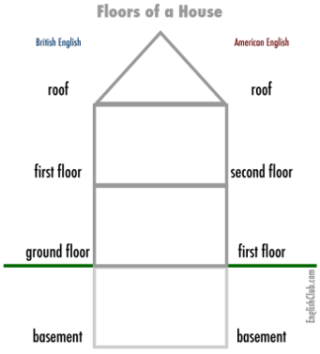

Slide 46
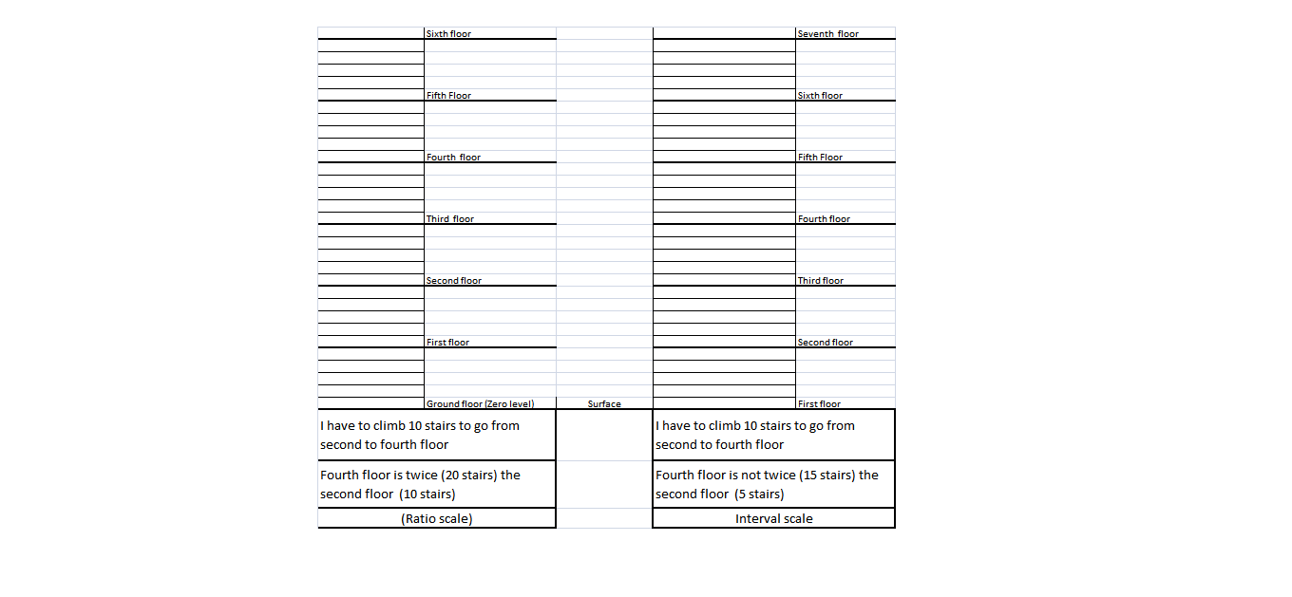

Slide 47
1
2
3
4
5
6
7
8
9

